Slide 1
DATA PROTECTION IN CLOUD
Cloud data protection is the practice of securing a company’s data in a cloud environment.
Wherever that data is located , whether its at rest or in motion and whether its managed internally by the company or externally by a third party.

Slide 2
Types of cloud design patterns
Basically cloud design patterns are two types
Cache aside pattern
Shared aside pattern
1.CACHE MEMORY :-
Cache memory is a chip –based computer component that makes retrieving data from the computer’s memory more efficient . It acts as a temporary storage area that the computer’s processor can retrieves the data from easily. This temporary storage area known as a cache memory
2.SHARED MEMORY:-
Shared memory is a memory that may be simultaneously accessed by multiple programs with an intetion to provide communication among them or avoid redundant copies

Slide 3

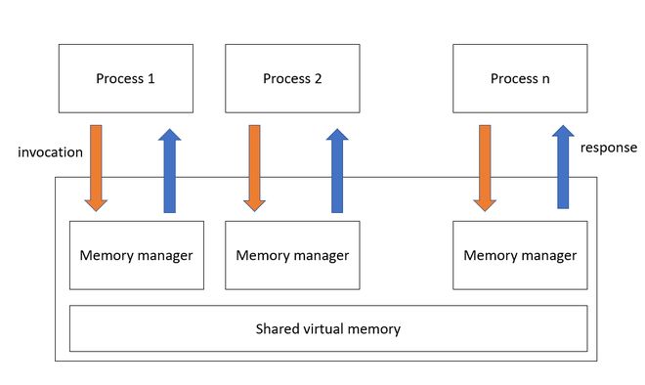
EXAPLES OF CACHE AND SHARED MEMORY

Slide 4
Shared memory patterns :-
Shared memory patterns are of two types
Vertical shared :-scale up
Horizontal shared :-scale out
Sharing manger :-
RDS: - relational database server
SQL:- structured query language

Slide 5
SQL DATA BASE
SQL DATA BASE : SQL data base is a collection of highly structured data tables , wherein each row a data entity , and every column defines a specific information field .
Relation data base are built using the structured query language to create , store , update and retrieve the data.
A data base is a table that consist of rows and columns .SQL is the language of database ,it facilitates retrieving specific informatin from database that are further used for analysis .

Slide 6
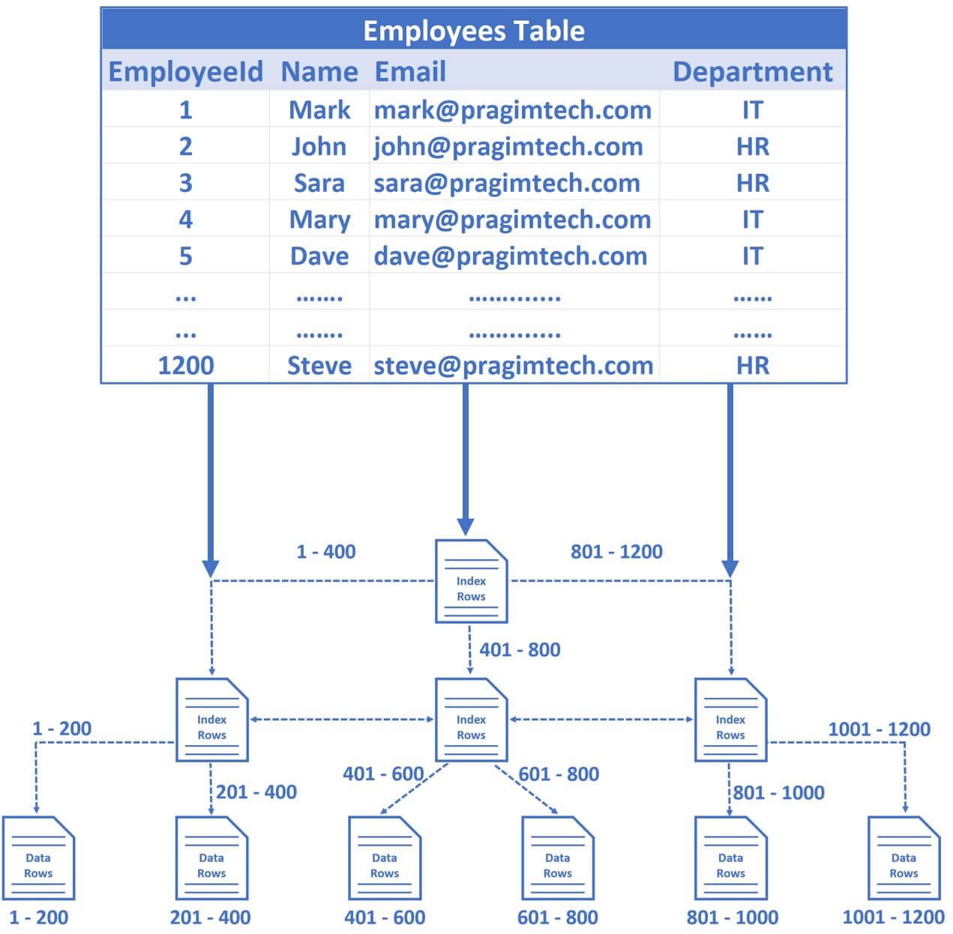

Sql database

Slide 7
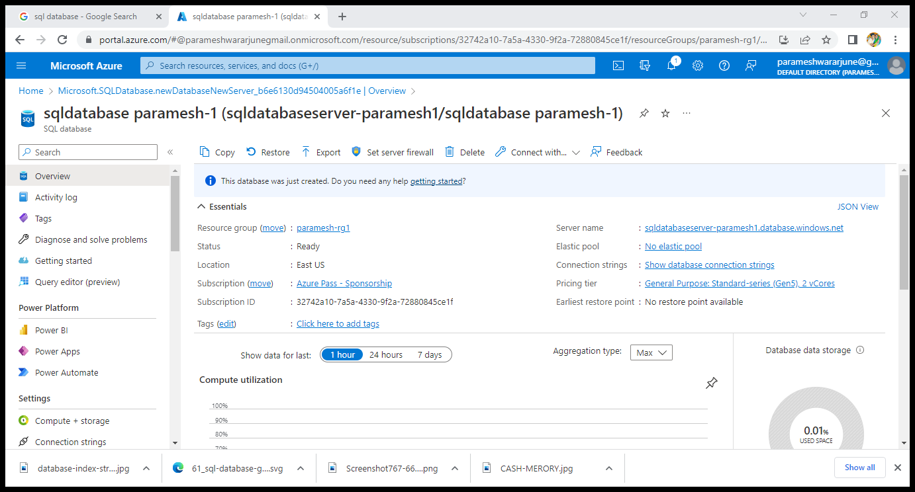
CREATION OF SQL DATABASE

Slide 8
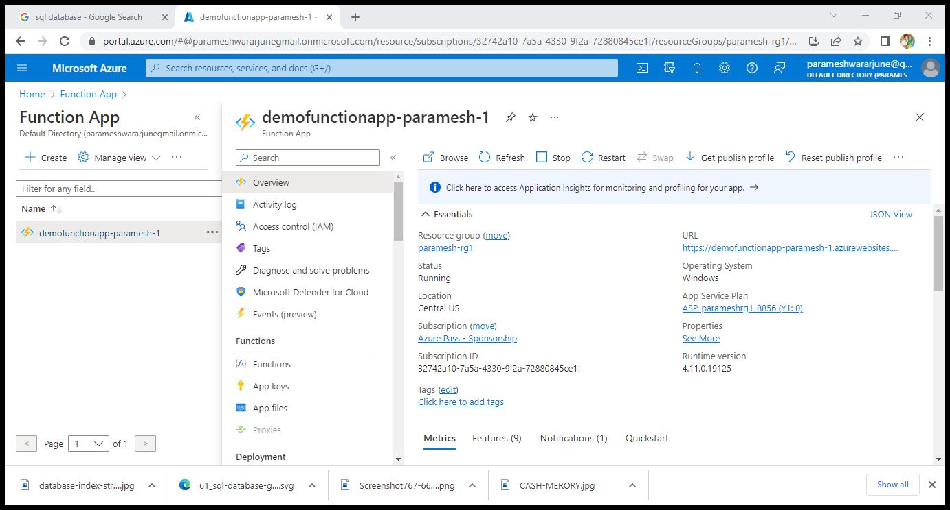
Creation of function apps

Slide 9
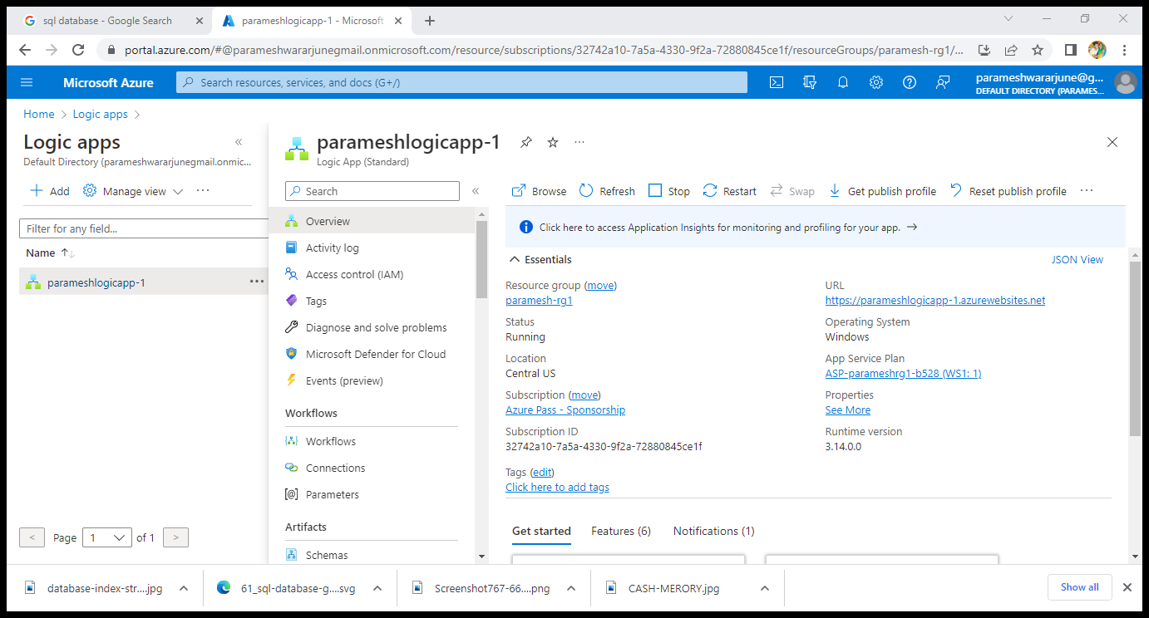
Creation of logic apps

